Slide 1
CSCE 5520
Wireless Networks and Protocols Wireless Challenges

Slide 2
Outline
Challenges in Wireless Networking
RF introduction
» A cartoon view
» Communication
» Time versus frequency view
Modulation and multiplexing
Channel capacity
Antennas and signal propagation
Modulation
Diversity and coding
OFDM

Slide 3
Why Use Wireless?
There are no wires!
Has several significant advantages:
Supports mobile users
» Move around office, campus, city, … - users get hooked
» Remote control devices (TV, garage door, ..)
» Cordless phones, cell phones, ..
» WiFi, GPRS, Bluetooth, …
No need to install and maintain wires
» Reduces cost – important in offices, hotels, …
» Simplifies deployment – important in homes, hotspots, …

Slide 4
What is Hard about Wireless?
There are no wires!
In wired networks links are constant, reliable and physically isolated
» A 1 GBps Ethernet always has the same properties
» Not true for “54 Mbps” 802.11a and definitely not for “6 Gbps” 802.11ac
In wireless networks links are variable, error- prone
» Link properties can be extremely dynamic
» For mobile devices they also differ across locations

Slide 5






Wireless is a shared medium
In wired communication, signals are contained in a conductor
» Copper or fiber
» Guides energy to destination
» Protects signal from external signals
Wireless communication uses broadcasting over the shared ether
» Energy is distributed in space
» Signal must compete with many other signals in same frequency band
Bob
Mary

Slide 6


Attenuation and Errors
Bob
Mary
In wired networks error rate 10⁻¹⁰ or less
» Wireless networks are far from that target
Signal attenuates with distance and is affected by noise and competing signals
Obstacles further attenuate the signal
Probability of a successful reception depends on the “signal to interference and noise ratio”
- the SINR
More details later in the course

Slide 7



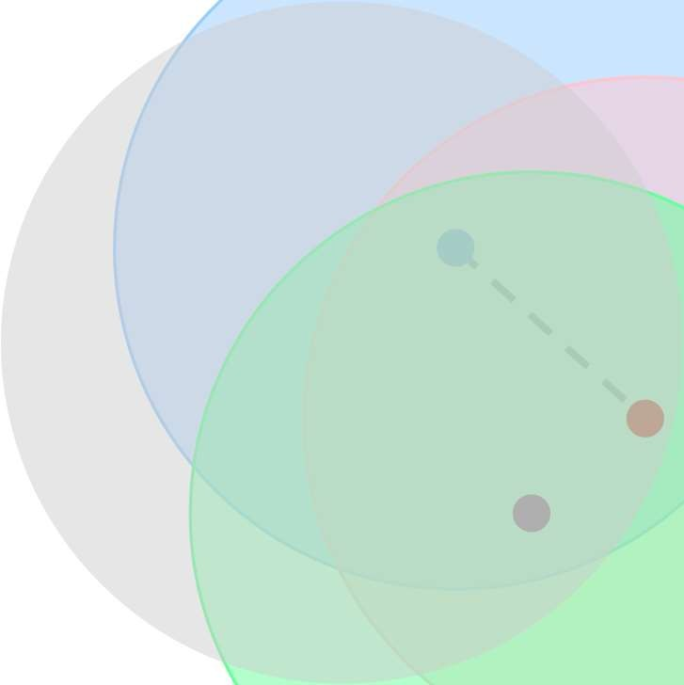
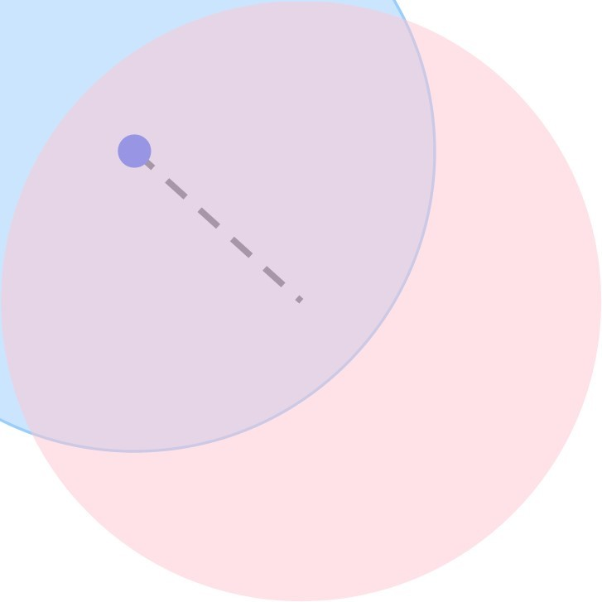
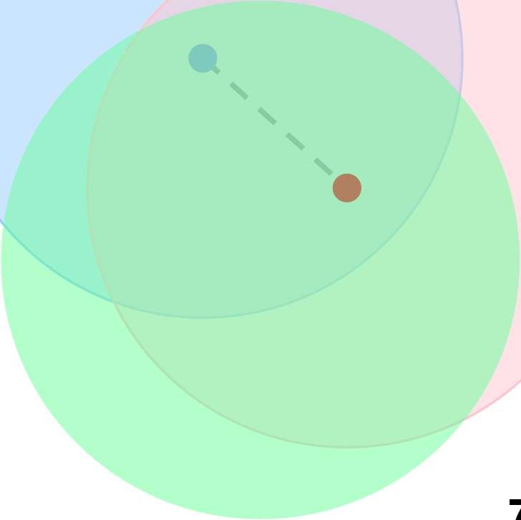




How Do We Increase Network Capacity?
Bob
Mary
Easy to do in wired networks: simply add wires
» Fiber is especially attractive
Adding wireless “links” increases interference.
» Frequency reuse can help … subject to spatial limitations
» Or use different frequencies … subject to frequency limitations
The capacity of the wireless network is fundamentally limited.

Slide 8

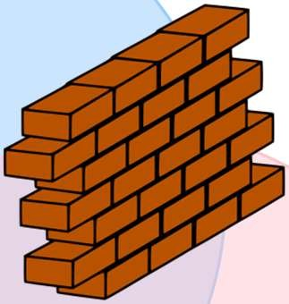




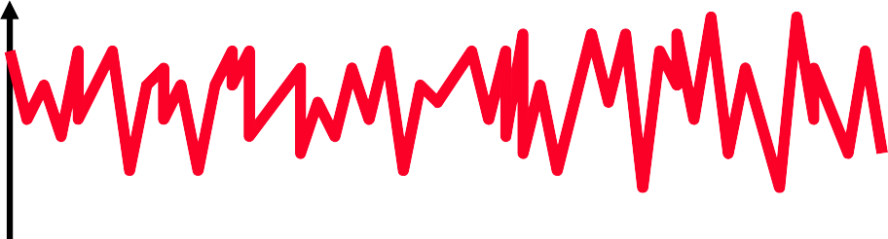
Mobility Affects the Link Throughput
Quality of the transmission depends on distance and obstacles blocking the “line of sight” (LOS)
» “Slow fading” – the signal strength changes slowly
Reflections off obstacles combined with mobility can cause “fast fading”
» Very rapid changes in the signal
» More on this later
Hard to predict signal!
Bob
Mary

Slide 9
How is Wireless Different?
Wired
Physical link properties are fixed and specified in standards
Designed for low error rates and throughput is fixed and known
Datalink layer is simple and optimized for the physical layer
Internet was designed assuming low error rates
Wireless
Physical link properties can change rapidly in unpredictable ways
Error rates vary a lot and throughput is very dynamic
How do you design an efficient datalink protocol?
How well will higher layer protocols work?

Slide 10
Implications of Variability in Wireless PHY Layer
Wireless datalink protocols must optimize throughput across an unknown and dynamic transmission medium
» Important to understand what causes the changes
Wireless “links” as observed by layers 3-7 will be unavoidably different from wired links
» Variable bandwidth and latency
» Intermittent connectivity
» Must adapt to changes in connectivity and bandwidth
Understanding the physical layer is the key to making wireless work well
» High level intuition is sufficient

Slide 11
Outline
Challenges in Wireless Networking
RF introduction
» A cartoon view
» Communication
» Time versus frequency view
Modulation and multiplexing
Channel capacity
Antennas and signal propagation
Modulation
Diversity and coding
OFDM

Slide 12
From Signals to Packets
Packet Transmission
Sender Receiver
01000101010111001010101010111011100000011110101011101010101011010110101
Packets
Header/Body Header/Body Header/Body
0 0 1 0 1 1 1 0 0 0 1
Bit Stream
“Digital” Signal
Analog Signal
12

Slide 13
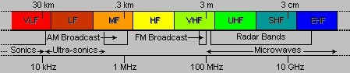
RF Introduction
RF = Radio Frequency
» Electromagnetic signal that propagates through “ether”
» Ranges 3 KHz .. 300 GHz
» Or 100 km .. 0.1 cm (wavelength)
Travels at the speed of light
Can take both a time and a frequency view
13

Slide 14

Cartoon View 1 – A Wave of Energy
Think of it as energy that radiates from an antenna and is picked up by another antenna.
Helps explain properties such as attenuation
» Density of the energy reduces over time, distance
» Signal strength is reduced, error rates go up
Relevance to networking?
» Error rates of “wireless” depend on distance
Also depends on many properties
» Notion spatial reuse of frequencies
Basis of cellular and WiFi infrastructures
14

Slide 15

Cartoon View 2 – Rays of Energy
Can also view it as a “ray” that propagates between two points
» Rays can be reflected etc.
» A channel can include multiple “rays” that take different paths – “multi-path” effect
Implications for wireless networks
» We can have provide connectivity without line of sight!
» Receiver can receive multiple copies of the signal, which leads to signal distortion
» Combined with mobility, it also leads to fast fading
15

Slide 16

(Not So) Cartoon View 3 – Electro-magnetic Signal
Signal that propagates and changes over time with a certain frequency and has an amplitude and phase
» Think: sine wave
Relevance to networking?
» The sender can change the properties of the EM signal over time to convey information
» Receivers can observe these changes and extract the information
16

Slide 17
Dealing With Bit Errors
Wireless vs. wired links
Wired: most loss is due to congestion
Wireless: higher, time-varying bit-error ate
Dealing with high bit-error rates
Sender could increase transmission power
Requires more energy (bad for battery-powered hosts)
Creates more interference with other senders
Stronger error detection and recovery
More powerful error detection codes
Link-layer retransmission of corrupted frames
18

Slide 18
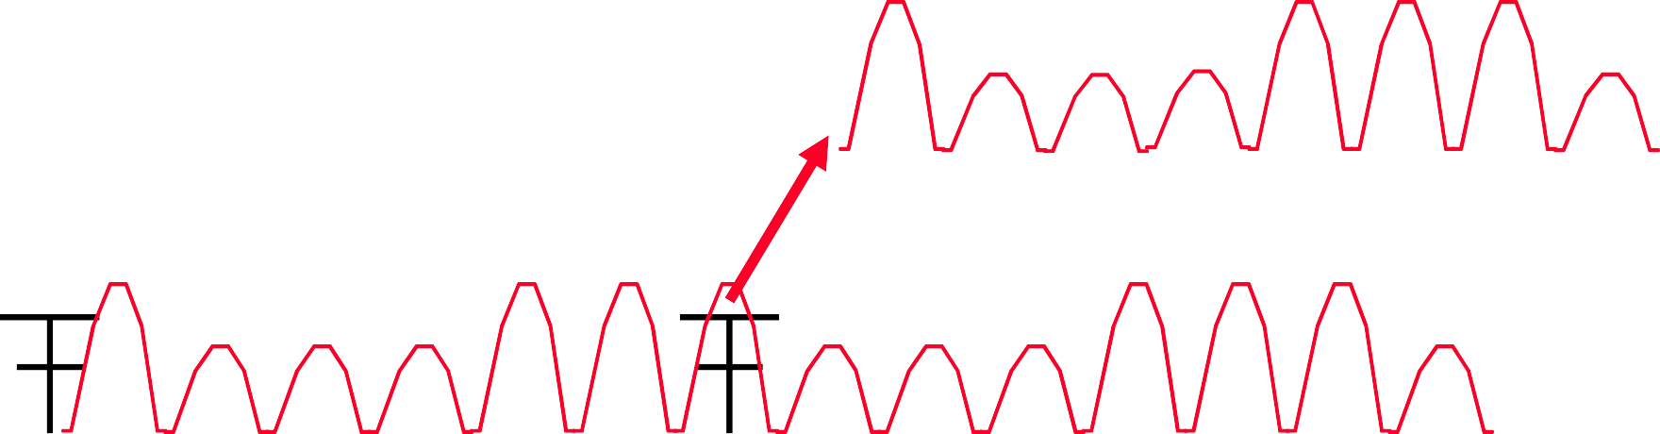
Communication
Remember: Cartoon view
Received Signal
Time (point in space)
Transmitter
Space (snapshot in time)
Sender changes signal in agree upon way and receiver interprets the changes
» “Modulation” and “Demodulation”
Problem: the signal gets distorted on “channel”
» Makes it harder for receiver to interpret changes

Slide 19
Sine Wave Parameters
General sine wave
» s(t ) = A Sin(2πft + θ)
A = Amplitude, f = Frequency,
θ = Phase, Period T = 1/f,
Frequency is measured in Cycles/sec or Hertz

Slide 20
Sine Wave Parameters
A = 1, f = 1 Hz, θ = 0; thus T = 1s
Reduced peak amplitude; A=0.5
Increased frequency; f = 2, thus T = ½
Phase shift;  θ = ¼ radians (45 degrees)
note: 2 radians = 360° = 1 period

Slide 21
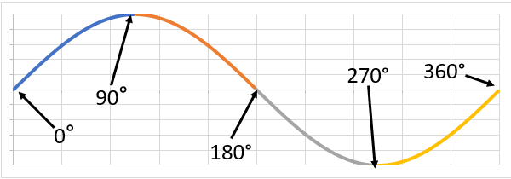
Phase
Phase is measurement of the sine wave, and it indicates where the wave is in its cycle. It is measured in degrees (0°-360°) or radians (0-2π) and is denoted with the Greek symbol Phi (ϕ).

Slide 22
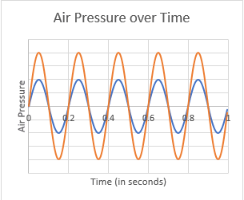
Amplitude
Amplitude indicates how far the wave deviates from its position of rest.

Slide 23
Wavelength
Wavelength is the distance between identical points (adjacent crests) in the adjacent cycles of a waveform signal propagated in space or along a wire.
Wavelength is inversely related to frequency, which refers to the number of wave cycles per second. The higher the frequency of the signal, the shorter the wavelength.
Wavelength = λ
Assuming signal velocity v
λ= vT
λf = v
c = 3×108 m/s(speed of light in free space) = 300 m/μs

Slide 24
Example
Frequency = 2.5 GHz
λ = c/f
= 300m/μs

Slide 25
Key Idea of Wireless Communication
The sender sends an EM signal and changes its properties over time
» Changes reflect a digital signal, e.g., binary or multi-valued signal
» Can change amplitude, phase, frequency, or a combination
Receiver learns the digital signal by observing how the received signal changes
» Note that signal is no longer a simple sine wave or even a periodic signal

Slide 26
Outline
Challenges in Wireless Networking
RF introduction
» A cartoon view
» Communication
» Time versus frequency view
Modulation and multiplexing
Channel capacity
Antennas and signal propagation
Modulation
Diversity and coding
OFDM

Slide 27
Challenge
Wireless network designers need more precise information about the performance of wireless “links”
» Can the receiver always decode the signal?
» How many Kbit, Mbit, Gbit per second?
» Does the physical environment, distance, mobility, weather, season, the color of my shirt, etc. matter?
We need a more formal way of reasoning about wireless communication:
Represent the signal in the frequency domain!

Slide 28
Time Domain View: Periodic versus Aperiodic Signals
Periodic signal - analog or digital signal pattern that repeats over time
»
s(t +T ) = s(t )
– where T is the period of the signal
» Allows us to take a frequency view – important to understand wireless challenges and solutions
Aperiodic signal - analog or digital signal pattern that doesn't repeat over time
» Hard to analyze
Can “make” an aperiodic signal periodic by taking a time slice T and repeating it
» Often what we do implicitly

Slide 29
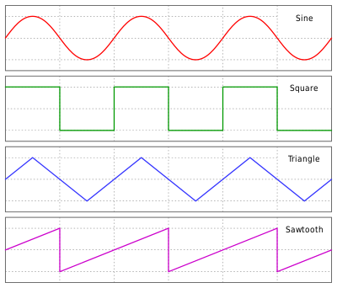
common periodic waveforms

Slide 30
Key Property of Periodic EM Signals
Any electromagnetic signal can be shown to consist of a collection of periodic analog signals (sine waves) at different amplitudes, frequencies, and phases
The period of the total signal is equal to the period of the fundamental frequency
» All other frequencies are an integer multiple of the fundamental frequency
There is a strong relationship between the “shape” of the signal in the time and frequency domain

Slide 31
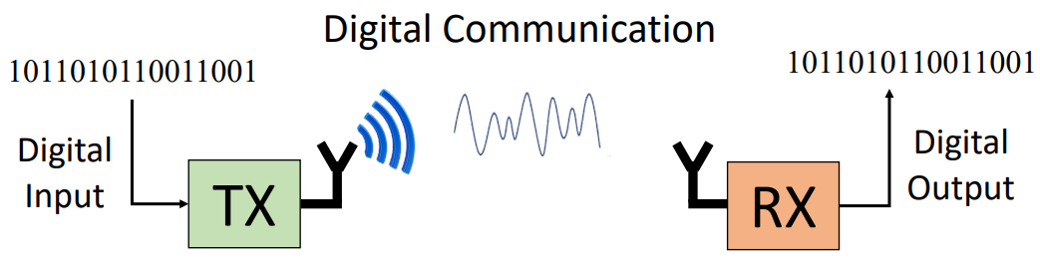
Analog vs. Digital Communication System

Slide 32
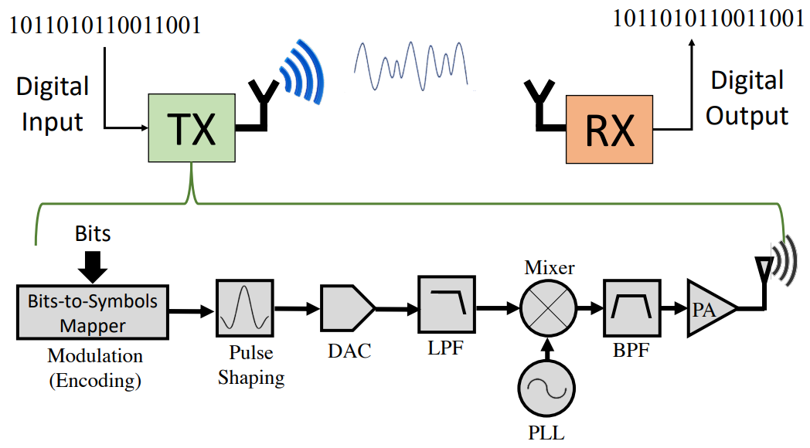
Wireless Communication System

Slide 33
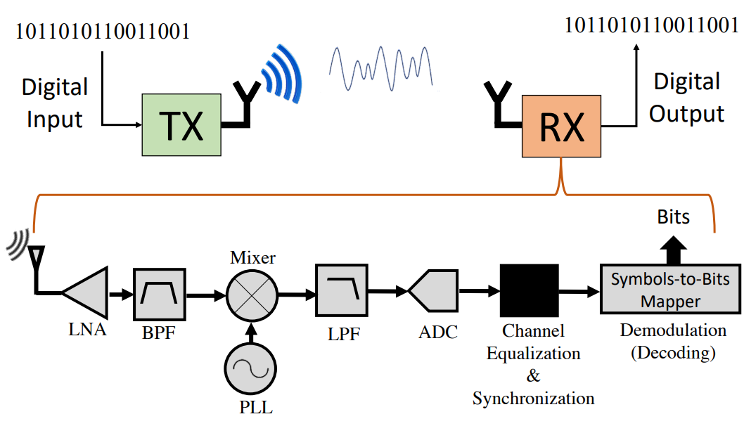
Wireless Communication System

Slide 34
Coding Terminology
Notes:
A pulse in signal processing is a rapid, transient change in the amplitude of a signal from a baseline value to a higher or lower value, followed by a rapid return to the baseline value
It is the unit for symbol rate or modulation rate in symbols per second or pulses per second. It is the number of distinct symbol changes (signaling events) made to the transmission medium per second in a digitally modulated signal or a bd rate line code.

Slide 35
Signal Modulation
Modulation: the process of encoding the information from a message source in a manner suitable for transmission
Amplitude modulation (AM): change the strength of the carrier based on information
High values -> stronger signal
Frequency (FM) and phase modulation (PM): change the frequency or phase of the signal
Frequency or Phase shift keying
Digital versions are also called “shift keying”
Amplitude (ASK), Frequency (FSK), Phase (PSK) Shift Keying

Slide 36
Signal Modulation

Slide 37
Signal Modulation

Slide 38
Signal Modulation

Slide 39
Signal Modulation

Slide 40
Signal Modulation

Slide 41
Signal Modulation

Slide 42
Signal Modulation

Slide 43
Signal Modulation

Slide 44
Signal Modulation

Slide 45
Signal Modulation

Slide 46
Signal Modulation

Slide 47
Signal Modulation

Slide 48
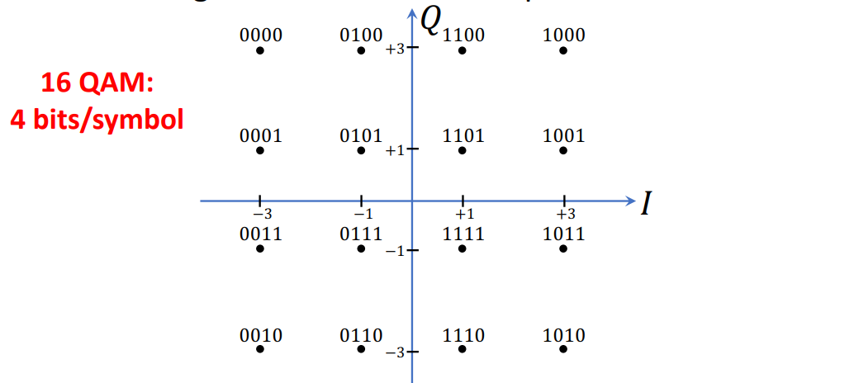
QAM

Slide 49
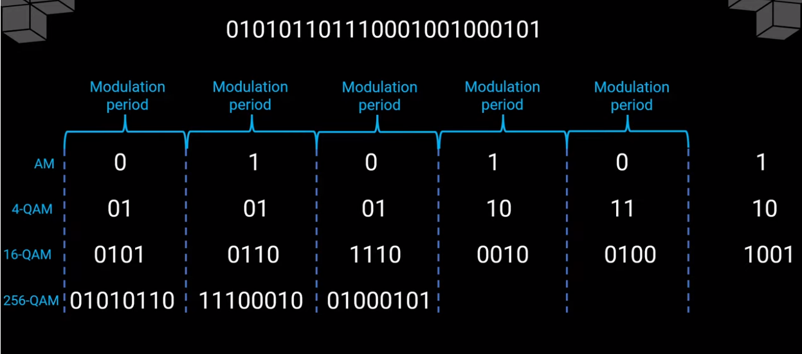
Example

Slide 50
BPSK Modulation

Slide 51
BPSK Modulation

Slide 52
BPSK Modulation

Slide 53
BPSK Modulation

Slide 54
BPSK Modulation

Slide 55
BPSK Modulation

Slide 56
Signal Modulation

Slide 57
QAMs

Slide 59
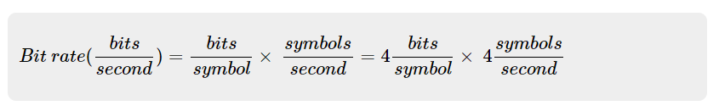
Numeric example
For a communication system, the 4 bits are encoded per symbol and four symbols are transmitted per second. Compute the bit rate of the system
Multiple bits are encoded per symbol to increase the bit rate
By substituting the known values, we can find the bit rate of the system to be 16 bits/second.

Slide 60
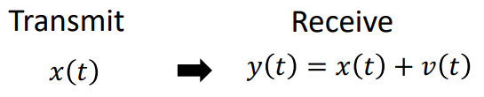
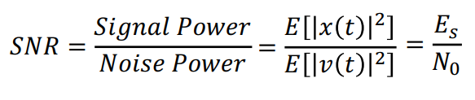
Noise
Circuit Components and wireless channel add noise to the wireless signal.
v(t) is Additive White Gaussian Noise (AWGN)
High noise is bad -> Cannot decode Bits correctly Low noise is good -> Can decode Bits correctly
Signal-to-Noise Ratio (SNR)

Slide 61
Noise
The noise level indicates the amount of background noise in your environment.
If the noise level is too high, it can result in degraded strength and performance for your wireless signal strength.
Noise level is measured in -dBm format (0 to -100). This is the power ratio in decibels (dB) of the measured power referenced to one milliwatt.
The closer the value to 0, the greater the noise level.
Negative values indicate less background noise. For example, -96dBm is a lower noise level than -20dBm.

Slide 62
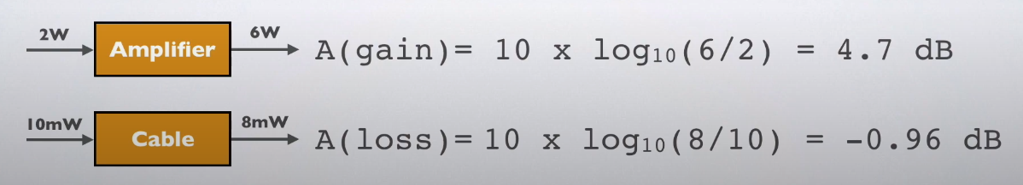
Decibel (dB)
The decibel (dB) is a unit used to express the ratio of powers of sound pressure, signal strength or other things on logarithmic scale.
The decibel is a relative unit of measurement equal to one tenth of a bel (B), invited by Bell Labs and named after Alexander Graham Bell.
Decibel = 10 * log10 (P_{o}/P_{i}) dB
_{Where} P_{o is output power and} P_{i is an input power}

Slide 63
Decibel (dB)
Note decibel is a relative value
decibel-watt (db) = power relative to 1W
Decibel-milliwatt(dBm) = power relative to 1 milliwatt
The logarithmic scale is used to is to avoid dealing with very high and very low numbers, meaning the ratio. Using decibels is easy to work with
For example:
A power of ratio of 1,000,000 (1million) can be expressed by 60dB
A power of ratio of 0.000001 can be expressed by -60dB
A power of ratio of 1,000,000,000,000,000 (1quadrillion) can be expressed by 150dB
A power of ratio of 0.000000000000000 1 can be expressed by -150dB

Slide 64
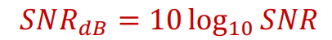
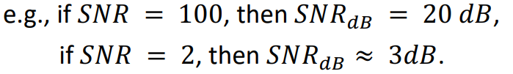
Signal to Noise Ratio
Ratio of the power in a signal to the power contained in the noise that’s present at a particular point in the transmission
Typically measured at a receiver
Signal-to-noise ratio (SNR, or S/N)
SNR is a essential parameter that shows signal quality
high SNR means a high-quality signal, low number of required intermediate repeaters
A low SNR means low quality signal, may require further signal processing to recover original signal
We typically measure SNR in db scale

Slide 65
Channel Capacity
Channel capacity is a maximum information rate that a channel can transmit. It is measured in bits per second (bps). Channel capacity is a rough value as measuring takes into account only the whole amount of data transferred but leaves out of account communication quality.
Bandwidth can be considered as a subset of channel capacity term. When bandwidth is measured, the maximum volume of information that can be accurately transferred per unit of time is taken into account.
For example, channel capacity may be very high, but low signal quality would make bandwidth low as well.

Slide 66
Concepts related to Channel Capacity
Data rate - rate at which data can be communicated (bps)
Bandwidth - the bandwidth of the transmitted signal as constrained by the transmitter and the nature of the transmission medium (Hertz)
Noise - average level of noise over the communications path
Error rate - rate at which errors occur
Error = transmit 1 and receive 0; transmit 0 and receive 1
Implying the probability of one bit error
Example : Bit error rate of 10⁻³ means probability of a single bit flipped, or in other words, in every 1000 bit, one bit error is found

Slide 67
Concepts related to Channel Capacity
Channel Capacity
Channel can be thought as a pipe, which certain maximum water (bit) can flow (propagate) through
Channel capacity infer the maximum number of bit per unit time that can transmitted through a channel with a very small bit error rate.
Wireless channel capacity
Transmitting digital data using analog signal
Shannon Channel Capacity
Upper bound channel capacity, with present of noise regardless channel coding scheme,
Never being reached in practice
Where C is the channel capacity (in bit/second), B is the channel bandwidth (Hz), and SNR is signal to noise ratio quantity (It is in linear scale)
C = B log ₂(1+SNR)

Slide 68
Shannon’s Theorem

Slide 69
The Nyquist Limit
A noiseless channel of bandwidth B can at most transmit a binary signal at a capacity 2B
» e.g., a 3000 Hz channel can transmit data at a rate of at most 6000 bits/second
» Assumes binary amplitude encoding
For M levels: C = 2B log2 M
» M discrete signal levels
More aggressive encoding can increase the actual channel bandwidth
» Example: modems
Factors such as noise can reduce the capacity

Slide 70
Example

Slide 71
Example

Slide 72
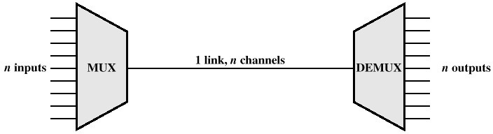
Multiplexing
Capacity of the transmission medium usually exceeds the capacity required for a single signal
Multiplexing - carrying multiple signals on a single medium
» More efficient use of transmission medium
A must for wireless – spectrum is huge!
» Signals must differ in frequency (spectrum), time, or space

Slide 73
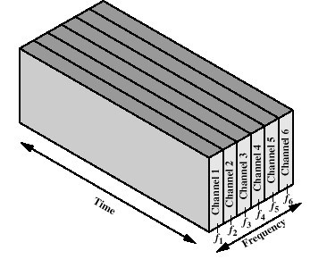
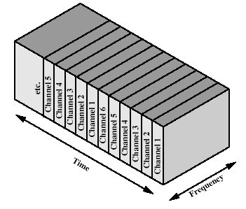
Multiplexing Techniques
Frequency-division multiplexing (FDM)
» divide the capacity in the frequency domain
Time-division multiplexing (TDM)
» Divide the capacity in the time domain
» Fixed or variable length time slices

Slide 74
Multiple Users Can Share the Ether
Frequency
Different users use Different carrier frequencies

Slide 75

Frequency versus Time-division Multiplexing
With frequency-division
multiplexing different users use
different parts of the frequency spectrum.
» I.e. each user can send all the time at reduced rate
» Example: roommates
» Hardware is slightly more expensive and is less efficient use of spectrum
With time-division multiplexing
different users send at different times.
» I.e. each user can sent at full speed some of the time
» Example: a time-share condo
» Drawback is that there is some
transition time between slots;
becomes more of an issue with longer propagation times
The two solutions can be combined.
Frequency
Frequency Bands
Slot |  |  | Frame
Time

Slide 76







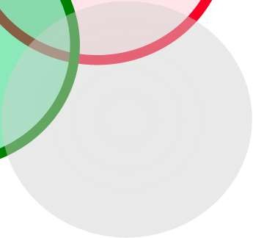








Frequency Reuse in Space
Frequencies can be reused in space
» Distance must be large enough
» Example: radio stations
Basis for “cellular” network architecture
Set of “base stations” connected to the wired network support set of nearby clients
» Star topology in each circle
» Cell phones, 802.11, …

